Slide 1
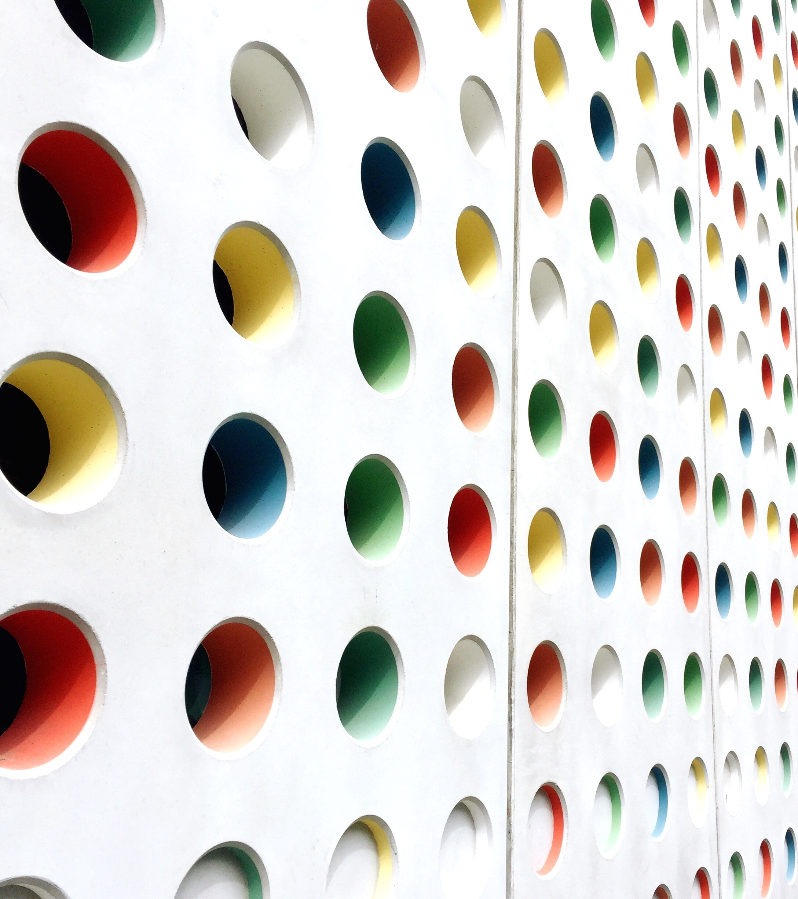
RegTransform Challenge
Ahmad ammari

Slide 2
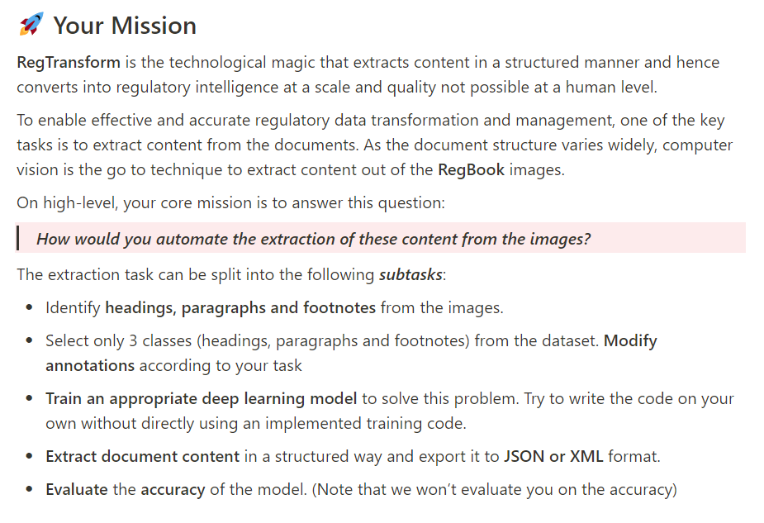
Objective
To address the RegTransform Take-Home challenge
Capture AI - RegTransform Take-home Challenge:
https://chrome-alphabet-530.notion.site/Capture-AI-RegTransform-Take-home-Challenge-71df4f9ff61243c9985db0e990b20a02#f7459fc1af3645bda954906d551da344

Slide 3
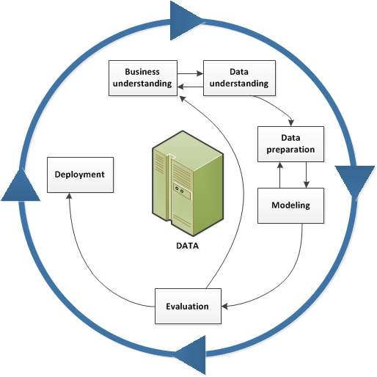
Methodology
Cross-Industry Standard Process for Data Mining CRISP-DM
Business Understanding
Data Understanding
Data Preparation
Modelling
Evaluation
Deployment

Slide 4
Business Understanding
RegBook is a main product by CUBE which allows users to manage their inventory of relevant regulations
RegBook can also provide interesting signals about regulatory change before it happens
For this to occur, a core pre-requisite is to extract content from the documents
As the document structure varies widely, Computer Vision is the go-to technique to extract content out of the RegBook images
The objective of the challenge is to build a Deep Learning model to solve the above problem, focusing on extracting the textual content from three regions in the document images:
Headings
Paragraphs
Footnotes

Slide 5
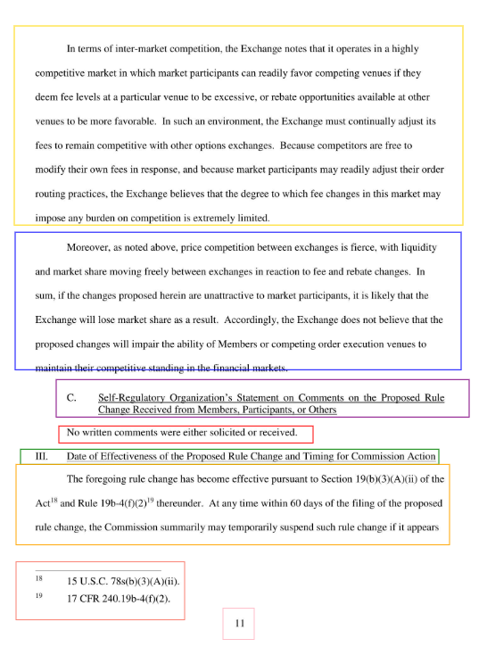
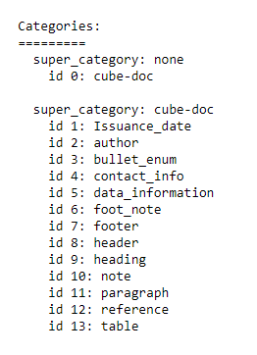
Data Understanding
The challenge has provided 301 document images annotated with the COCO format
These images have already been divided into train(80%), test(10%), and validate(10%) groups
To better understand the data, the COCO_Image_Viewer Jupyter Notebook has been created to explore the images and associated COCO meta-data
Data exploration shows that there are 13 classes

Slide 6
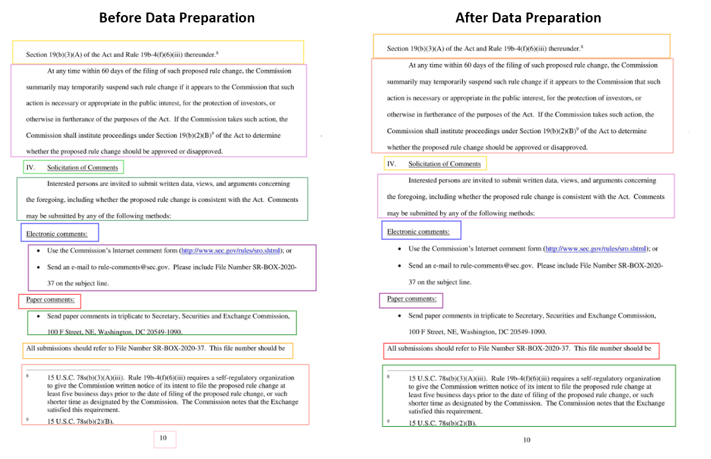
Data Preparation
Since the challenge requires the focus on three target classes only (headings, paragraphs, footnotes), a data preparation script, select_anno_from_coco.py, has been created to limit the categories and annotations of the training and validation data to those related to these target classes

Slide 7
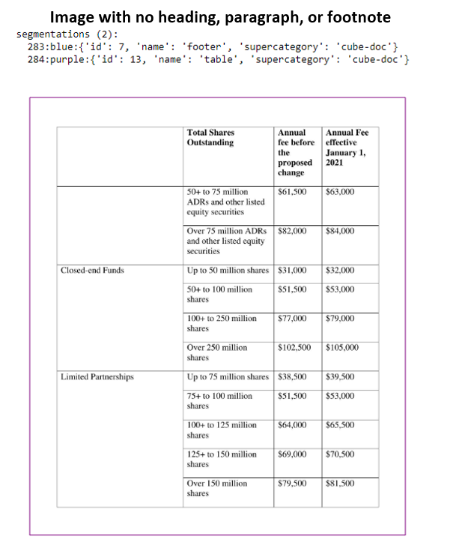
Data Preparation
A data preparation script, detect_faulty_anno_from_coco.py, has been created to detect faulty image(s) in the training dataset. Faulty images are those which do not have any valid labels to make it eligible to be used for object detection model training

Slide 8
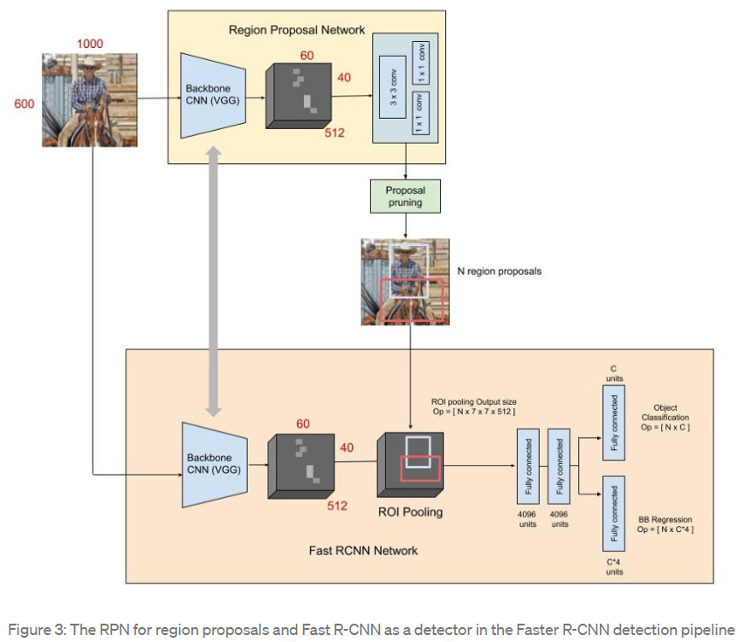
Modelling
Object Detection Algorithm Selected: The Faster RCNN Algorithm implemented in PyTorch
Number of Epochs: 1 (originally 6; has been set to 1 to save processing time given the assessment time limitation)
The following scripts have been created to train and evaluate the Deep Learning model
main.py: Main script for model training and evaluation
util.py: Utility script for creating custom datasets for training and testing and other helper and utility functions
config.py: Configuration script for storing paths to datasets and COCO files and model parameters
External utility and helper functions downloaded from the Torchvision repo
Run_Main: Jupyter Notebook used to run the model training, evaluation, and persistence logic to save & explore the processing logs.

Slide 9
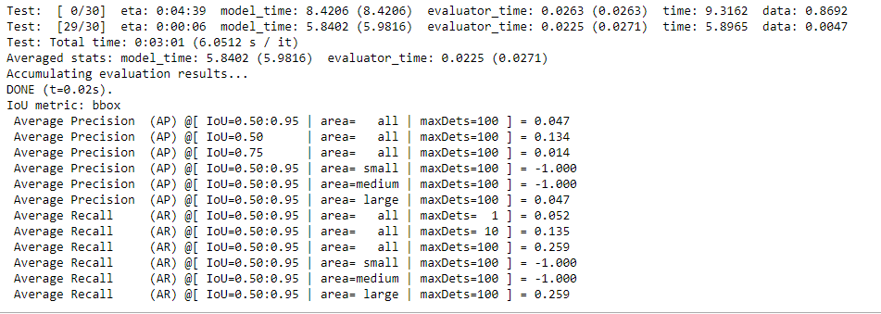
Evaluation
The model has been evaluated against the Images in the validation subset
Precision and Recall are the main Evaluation Criteria

Slide 10
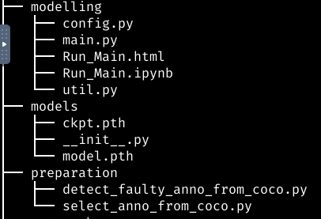
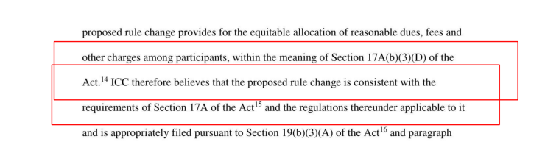
Deployment
Due to time limitation of the assessment, deployment has been limited to persisting the model and testing the model against a few images from the testing dataset
Persisted model weights have been saved to the models folder
The COCO_Inference Jupyter Notebook has been created to produce model predictions and explore detected classes in testing COCO image sample

Slide 11
Future Work
Due to time limitation of the assessment, the following subtasks have not been implemented
Improving the performance of the object detection model
Image Augmentation
Pseudo labeling
Ensembling
Test Time Augmentation(TTA)
Textual content extraction (OCR Model) from the document detected regions (headings, paragraphs, footnotes)
Tesseract OCR wrappers in Python (pytesseract, pyocr, tesserocr)
Cloud-based services (Google Cloud Vision API, Amazon Rekognition)
Textual content persistence / archiving into JSON output files
Python json module

Slide 12
Working Time
Total Working Time: 8 Hours
Research & Review of Related Work: 1 Hour
Code Development & Testing: 4 Hours
Code Execution & Processing: 2 Hours
Documentation: 1 Hour
References
Capture AI - RegTransform Take-home Challenge
Getting started with COCO dataset
How to train an Object Detector with your own COCO dataset in PyTorch
Pytorch Starter - FasterRCNN Inference

Slide 13

Thank you

